Slide 1
Probability & Statistics · Applied R Analysis
Supermarket
Customer Behavior
SuperMarket_Analysis.csv · n = 1,000 Transactions · Jan–Mar 2019 · Group 8
1K
3
6
TRANSACTIONS
Dataset Size
BRANCHES
Alex · Giza · Cairo
PRODUCT LINES
Categories Covered
FY Computer Science · Group 8 · Probability & Statistics Project · 2024-25

Slide 2
S
1. Context & Problem Framing
Theme: Why This Study Exists
Concept
Real-Life Relevance
Supermarkets generate massive transactional data daily.
📦
Staffing decisions based on arrival rates
Businesses need statistical modeling for decision-making.
Theory
🏪
Inventory management using demand models
Data-driven decisions reduce uncertainty.
Probability helps model uncertain events.
👤
Customer targeting via Bayes theorem
What We Aim To Do
Analyze revenue distribution.
📊
Revenue forecasting with Normal distribution
Model customer arrivals.
Apply probability distributions.
R Code (briefly)
<> R
df <- read.csv(“SuperMarket Analysis.csv”)

Slide 3
S
2. Data Understanding & R Fundamentals
Theme: What Type of Data We Have
Concept
Total Transactions
Data frame structure in R
1,000
Numerical vs categorical variables
Columns / Variables
Mathematical View
Sales → continuous variable
17
Product line → categorical variable
Customer type → binary (Member / Normal)
Branches
Time → discrete (extracted hour)
3
Code
Product Lines
<> R
6
str(df) head(df) # View first 6 rows
Interpretation: Helps identify which statistical tools are appropriate.

Slide 4
S
3. Measures of Central Tendency
Theme: Location in Sales Data
Mean Sales
Median Sales
Std. Deviation
Member Rate
₹322.97
₹254.02
₹245.89
56.5%
x̄ = Σxᵢ / n
Middle value
σ = √Variance
565 of 1,000
R Code
<> R
mean_sales <- mean(df$Sales, na.rm=TRUE) median_sales <- median(df$Sales, na.rm=TRUE) variance_sales <- var(df$Sales) sd_sales <- sd(df$Sales) cat('Mean:', mean_sales) # 322.97 cat('Median:', median_sales) # 254.02
Interpretation
Mean > Median confirms right-skewed distribution — a few large purchases pull the average up.
Home & Lifestyle leads at ₹336.64

Slide 5
S
4. Measures of Dispersion
Theme: Variability in Sales
Mathematics
Output Meaning
Variance: σ² = Σ(xᵢ - x̄)² / n
SD = ₹245.89 → wide spending spread
SD = √Variance = ₹245.89
IQR shows spread of middle 50% customers
Range = Max – Min = ₹993.70
Interpretation
IQR = Q3 – Q1 (middle 50% spread)
Large SD → inconsistent revenue patterns
Q1 = ₹124.42 | Q3 = ₹471.35
Large IQR → wide middle spending variation
Code
High variance = unpredictable customer spend
<> R
Real-life
sd(df$Sales) range(df$Sales) quantile(df$Sales) IQR(df$Sales) summary(df$Sales)
Risk estimation in revenue forecasting
Pricing strategy and discount modeling
Variance
SD
₹60,460
₹245.89

Slide 6
S
5. Frequency Tables & Bar Diagram
Theme: Categorical Analysis
Concept
Frequency distribution of product lines.
Mathematics
Relative frequency = count / total
Code
<> R
table(df$Product.line) barplot(...)
Output Meaning
Identifies most sold product category.
Real-life
Inventory optimization and restocking.

Slide 7
Product Line — Frequency Table
table(df$Product.line) → sorted results
Product Line
Count
Rel. Freq (%)
Cum. Freq (%)
Electronic accessories
170
17.0%
17.0%
Fashion accessories
178
17.8%
34.8%
Food and beverages
174
17.4%
52.2%
Health and beauty
152
15.2%
67.4%
Home and lifestyle
160
16.0%
83.4%
Sports and travel
166
16.6%
100.0%
TOTAL
1,000
100%
Fashion accessories leads with 178 transactions · Health & Beauty lowest at 152

Slide 8
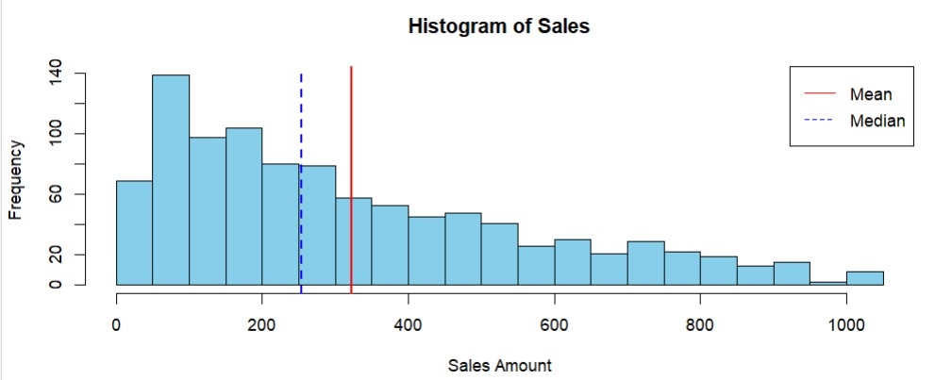
S
6. Histogram & Data Distribution
Theme: Shape of Distribution
Concept
Continuous distribution visualization.
Code
<> R
hist(df$Sales, breaks=30, col='skyblue', main='Histogram of Sales') abline(v=mean_sales, col='red', lwd=2) abline(v=median_sales, col='blue', lty=2)
Mathematical Insight
Skewness: Mean > Median → right tail
Comparison of mean vs median position
Real-life
─── Mean ₹322.97 (abline red) - - - Median ₹254.02 (abline blue, lty=2)
Predicts probability of large transactions.
Mean > Median → Positive skew (right-skewed distribution)

Slide 9
Heatmap — Branch × Product Line
heatmap(as.matrix(table(df$Branch, df$Product.line)))
Electronic accessories
Fashion accessories
Food and beverages
Health and beauty
Home and lifestyle
Sports and travel
Alex
60
58
59
62
65
59
Giza
55
21
57
50
58
45
Cairo
55
99
58
40
37
62
Key Findings
Cairo Fashion accessories (99) is highest — Electronics uniformly distributed ~55-60
Electronics uniformly distributed ~55-60 across all branches — consistent demand
dominates Health & Beauty (62) and Home & Lifestyle (65) COLOR CODE: 🟨 Bright Yellow (20-45) = Lowest | 🟠 Bright Orange (60-65) = Very High | 🟠 Medium Orange (50-60) = Average | 🔴 Dark Red (90-99) = Highest

Slide 10
S
7. Bayes' Theorem
Theme: Conditional Probability
Mathematics
P(A|B) = P(B|A) · P(A) / P(B)
P(Member)
P(Electronics)
P(Elec | Member)
P(Member | Elec)
0.5650
0.1700
0.1593
0.5294
565 of 1,000 are Members
170 of 1,000 buy electronics
90 of 565 members buy elec.
★ Final Answer
Code
Output Meaning
<> R
Probability a customer is a member
p_member <- mean(df$Customer.type == 'Member') p_elec <- mean(df$Product.line == 'Electronic accessories') p_elec_given_member <- mean( df$Product.line[df$Customer.type=='Member'] == 'Electronic accessories') p_member_given_elec <- (p_elec_given_member * p_member) / p_elec
given electronics purchase = 52.94%
Real-life
Targeted marketing strategies.

Slide 11
S
8. Discrete Distributions — Binomial & Poisson
Theme: Modeling Events
Binomial
Poisson
Mathematics
Mathematics
P(X=k) = C(n,k) · pᵏ · (1-p)ⁿ⁻ᵏ
P(X=k) = e⁻λ · λᵏ / k!
Code
Code
<> R
<> R
dbinom(3, size=10, prob=p_member) # Result: 0.0638 (6.38%)
dpois(x, lambda=lambda) # lambda = 1.62 arrivals/hr
Use
Interpretation
P(exactly 3 Members in 10 customers)
Models customer arrivals per hour
p = 0.565 → P(X=3) = 0.0638
λ = 1.62
P(X = 3) = 0.0638
Real-life
Queue management & staffing decisions.

Slide 12
Binomial Distribution — Full PMF Chart
P(X=k) for n=10, p=0.565 · dbinom(k, size=10, prob=0.565) · k=3 highlighted in amber
Key Values
P(X=0)
0.0002
P(X=1)
0.0026
P(X=2)
0.0161
P(X=3)
0.0638 ★
P(X=4)
0.1449
P(X=5)
0.2254
P(X=6)
0.2447
P(X=7)
0.1844
P(X=8)
0.0918
P(X=9)
0.0277
P(X=10)
0.0038
p = P(Member) = 565/1000 = 0.565 | Most likely outcome: k=6 (P=0.2447) | P(X=3) = 0.0638

Slide 13
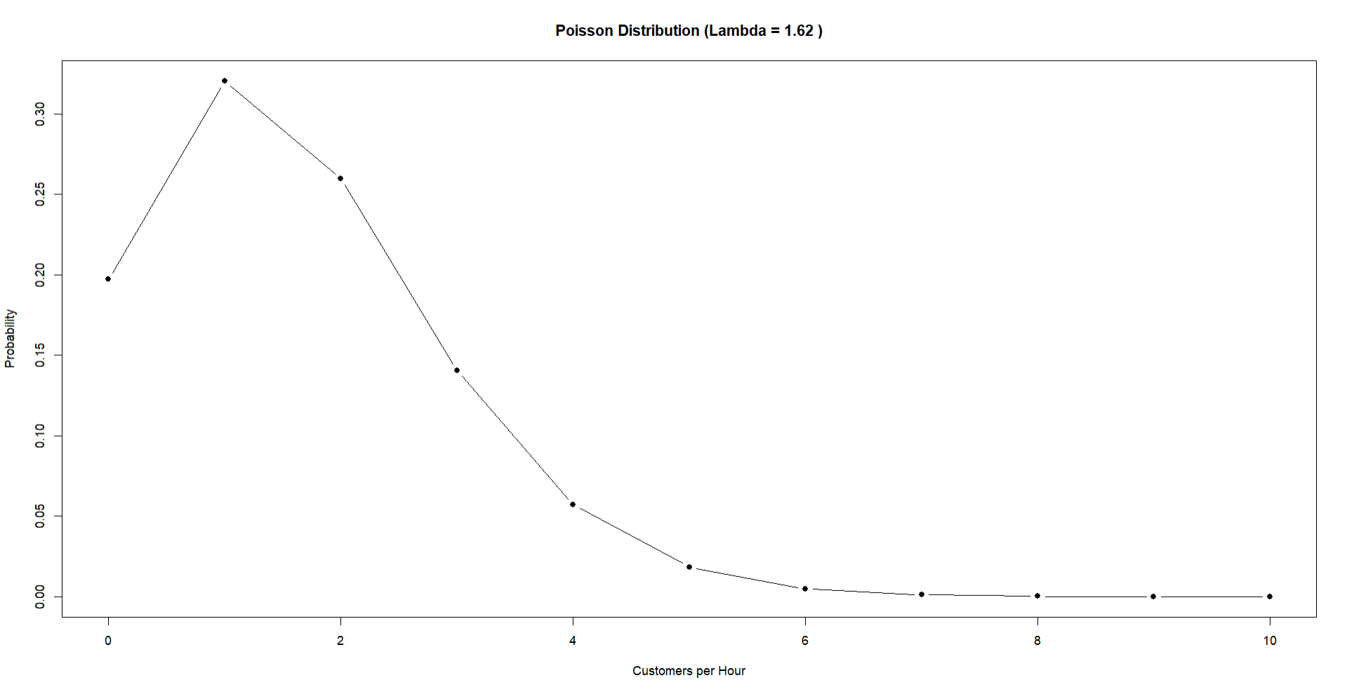
Binomial Distribution — Full PMF Chart
P(X=k) for n=10, p=0.565 · dbinom(k, size=10, prob=0.565) · k=3 highlighted in amber
Key Values
P(X=0)
0.0002
P(X=1)
0.0026
P(X=2)
0.0161
P(X=3)
0.0638 ★
P(X=4)
0.1449
P(X=5)
0.2254
P(X=6)
0.2447
P(X=7)
0.1844
P(X=8)
0.0918
P(X=9)
0.0277
P(X=10)
0.0038
p = P(Member) = 565/1000 = 0.565 | Most likely outcome: k=6 (P=0.2447) | P(X=3) = 0.0638

Slide 14
S
9. Continuous Distributions — Normal & Uniform
Normal Distribution
Uniform Distribution
Mathematics
Concept
f(x) = (1/σ√2π) · e^[-(x-μ)²/2σ²]
Equal probability over any interval.
μ = 322.97 · σ = 245.89
Mathematics
Code
f(x) = 1 / (b – a) for a ≤ x ≤ b
<> R
Code
dnorm(x_norm, mean_sales, sd_sales) hist(df$Sales, probability=TRUE) lines(x_norm, y_norm, col='red')
<> R
Interpretation
dunif(500, min=0, max=1000) # Result: 0.001
Shows theoretical comparison with sales data.
Real-life
Data approximately bell-shaped, slightly skewed.
Used when no outcome is favored.
μ ± 1σ
μ ± 2σ
Theoretical baseline comparison.
₹77–₹569 (68%)
₹0–₹815 (95%)
dunif(500, min=0, max=1000) = 0.001 Every value equally likely — used as reference.

Slide 15
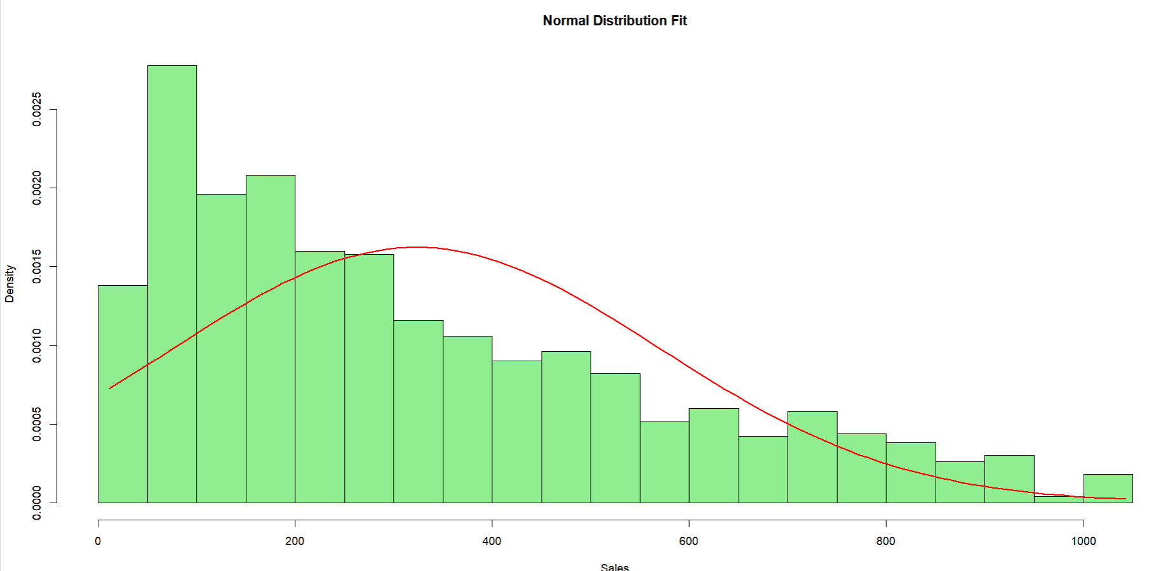
S
9. Continuous Distributions — Normal & Uniform
Normal Distribution
Uniform Distribution
Mathematics
Concept
f(x) = (1/σ√2π) · e^[-(x-μ)²/2σ²]
Equal probability over any interval.
μ = 322.97 · σ = 245.89
Mathematics
Code
f(x) = 1 / (b – a) for a ≤ x ≤ b
<> R
Code
dnorm(x_norm, mean_sales, sd_sales) hist(df$Sales, probability=TRUE) lines(x_norm, y_norm, col='red')
<> R
Interpretation
dunif(500, min=0, max=1000) # Result: 0.001
Shows theoretical comparison with sales data.
Real-life
Data approximately bell-shaped, slightly skewed.
Used when no outcome is favored.
μ ± 1σ
μ ± 2σ
Theoretical baseline comparison.
₹77–₹569 (68%)
₹0–₹815 (95%)
dunif(500, min=0, max=1000) = 0.001 Every value equally likely — used as reference.

Slide 16
S
10. CLT, Engineering Relevance & Conclusion
Theme: Big Picture
Central Limit Theorem
Engineering Relevance
Final Conclusion
Central Limit Theorem (Theory)
Engineering / Practical Relevance
Final Conclusion
If sample size n is large:
• Statistical modeling reduces uncertainty.
• Sales show positive skew.
X̄ ~ N(μ, σ²/n)
• Predictive models assist operations.
• Arrival fits Poisson (λ=1.62).
Even if population is skewed.
• Data-driven optimization.
• Bayes guides marketing (52.9%).
• Binomial models membership.
Why Important?
R Code (CLT Simulation):
• Normal distribution fits sales.
• Enables confidence estimation.
sample_means <- replicate(1000,
• Uniform = theoretical baseline.
• Allows normal approximation.
mean(sample(df$Sales,30,T)))

Slide 17
Results & Interpretation
What the numbers from SuperMarket_Analysis.csv actually tell us
📊 Right-Skewed Sales
Mean > Median = Positive Skew
🔵 Bayes Result
P(Mbr|Elec) = 52.94%
Mean ₹322.97 > Median ₹254.02
P(Member | Electronics) = 0.5294
Most customers spend below ₹254
52.9% of electronics buyers are Members
Few high-value purchases skew the mean
Target non-members for upgrade offers
📉 Poisson Arrivals
λ = 1.62 arrivals/hr
🏪 Branch Analysis
Giza leads ₹337/txn
λ = 1.62 customers per hour
Giza: ₹337.10 avg — highest
P(X=1) = 32.1% → most common
Cairo: ₹319.87 — Fashion (99 txns)
Schedule minimal off-peak staff
Alex: ₹312.35 — needs upsell strategy
📊 Binomial Peak
Peak at k=6 24.47% prob.
📐 Confidence Range
68% of all customers spend within ₹77 – ₹569
68% range ₹77–₹569
6 Members per 10 customers (24.47%) is most likely
P(X=6) = 0.2447 — highest probability in PMF
Defined by μ ± 1σ → 322.97 ± 245.89
p = 0.565 → majority of customers are Members
Normal distribution confirms bell-curve sales pattern

Slide 18
Project Summary
Key Takeaways
S1–2
Context & Data
1,000 transactions from 3 branches, imported & explored in R.
S3–4
Statistics
Mean ₹322.97, Median ₹254.02 — right-skewed distribution confirmed.
S5–6
Visualization
Histograms, barplots & heatmaps show product and branch patterns.
S7
Bayes
P(Member|Electronics) = 0.5294 — drives targeted member campaigns.
S8
Binomial/Poisson
P(3 Members in 10) = 6.38% · λ = 1.62 arrivals/hr.
S9–10
Distributions
Normal ~ N(323,246), Uniform = baseline, CLT validates inference.
Tools: R · Data: SuperMarket_Analysis.csv · Methods: Descriptive · Bayes · Binomial · Poisson · Normal · Uniform · CLT

